Slide 1



AI-DRIVEN JOB INTERVIEW ANALYZER
Short Title: Interview Den (S25-47-D)
Team: Hamza Saeed 21i-0671
Waleed Saeed 21i-1672
Asad Ullah Shah 21i-0545
Supervisor: Dr. Mehreen Alam

Slide 2
Project Focus
The AI-Driven Job Interview Analyzer aims to automate and optimize the hiring process by leveraging AI.
Our Goal
AI Resume Screening
AI Test Creation
AI Interview
AI based Scoring and Insights
Recap

Slide 3
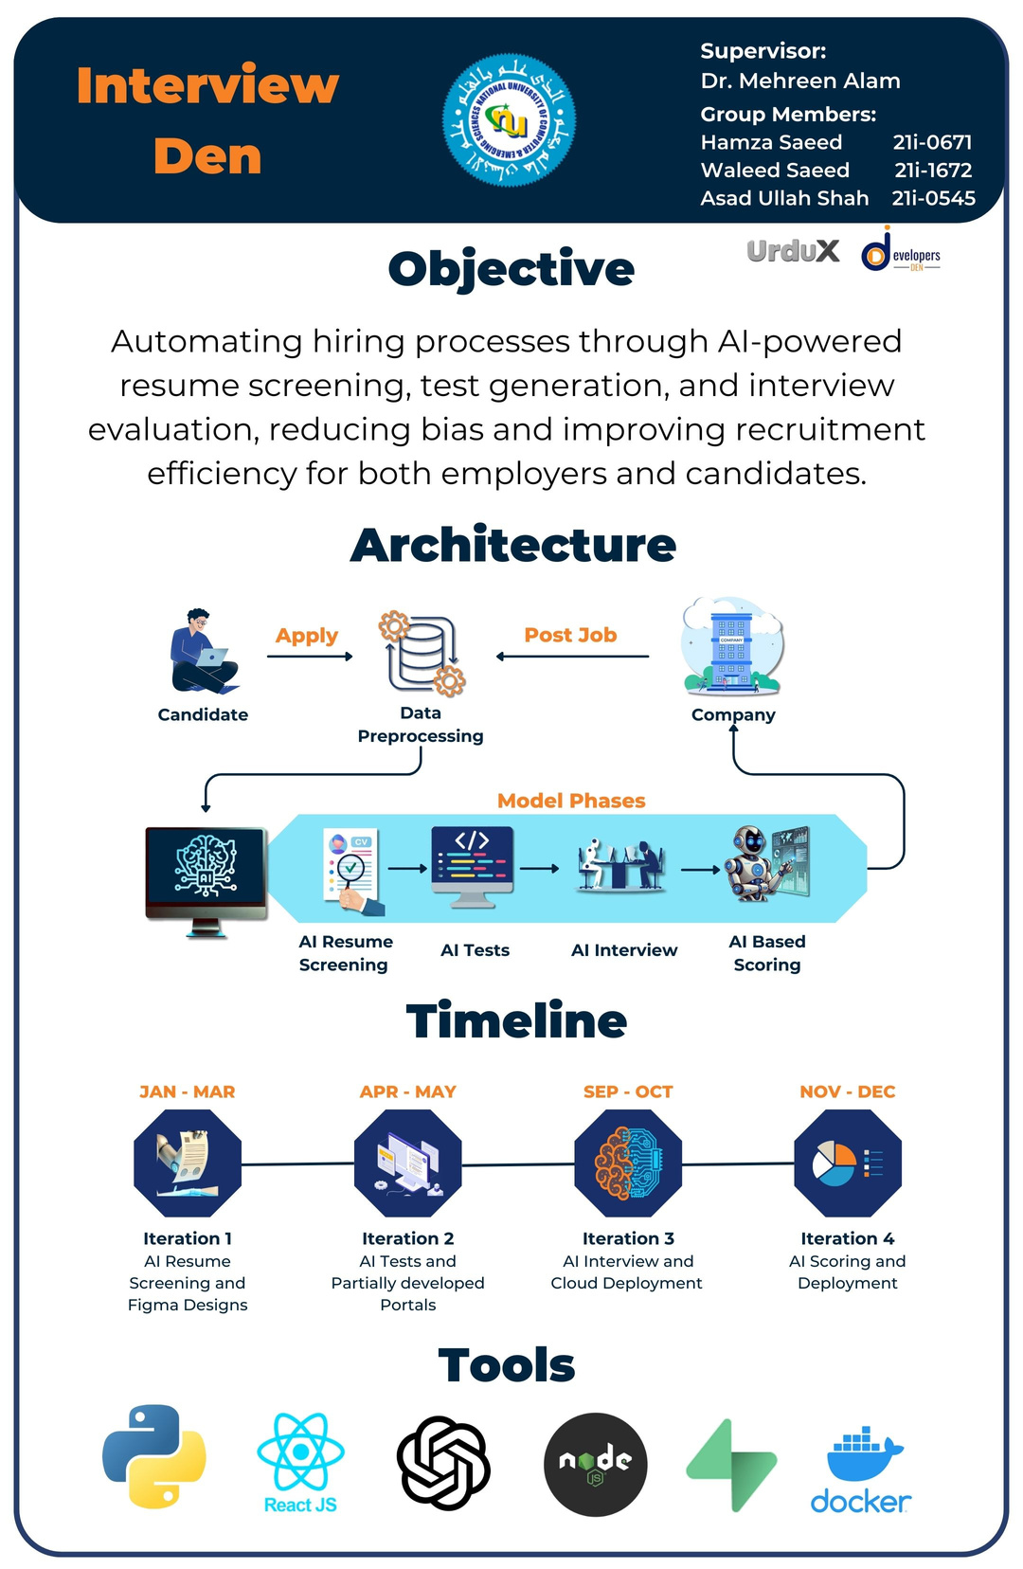
Poster

Slide 4
Feedback
Database: SupaBase
Diagram on Next slide

Slide 5
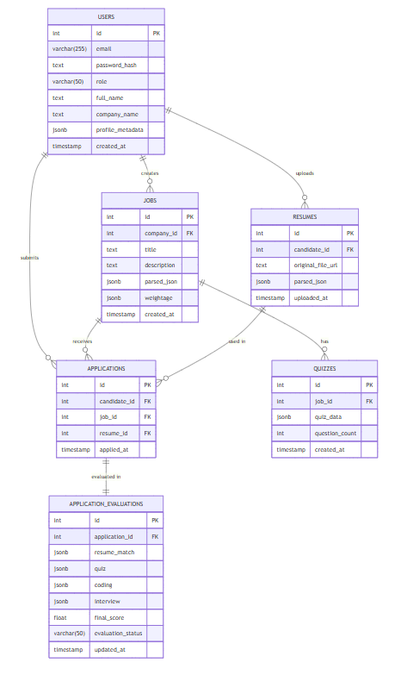
Domain Model Diagram

Slide 7
Iteration 2
APR-MAY
Develop company-side test creation portal:
- Model Training
- Multiple choice question system
- Question bank management
- Test difficulty settings
Implement test scoring system
Create basic analytics dashboard for companies
Iteration 4
NOV - DEC
Integrate all components into a seamless workflow
Implement detailed reporting system:
- Candidate performance analytics
- Interview insights
- Skill assessment reports
Final testing and optimization
Documentation and deployment preparation
Timeline
Iteration 1
JAN-MAR
Set up project infrastructure and basic architecture
Develop basic login/signup
Create company and candidate portals (Figma)
Implement core resume screening AI:
- Resume parsing system
- Basic job description matching
- Initial CV analysis algorithms
Unit testing, Poster making
Iteraton 3
SEP-OCT
Develop AI-powered interview system:
- Voice-based question handling
- Natural language processing for responses
- Technical assessment modules
- Communication skills evaluation
Implement real-time interview feedback
Create comprehensive candidate evaluation system

Slide 8
AI Resume Screening
AI Test Creation
AI Interview
AI Scoring and Analytics
Integration
Modules

Slide 9
This Module
1. AI Test Creation
Dynamic MCQ Test creation according to the job description
Automatic difficulty according to job level and role
Question bank to choose Questions
Test Scoring
2. Role Based Login/ signup

Slide 10
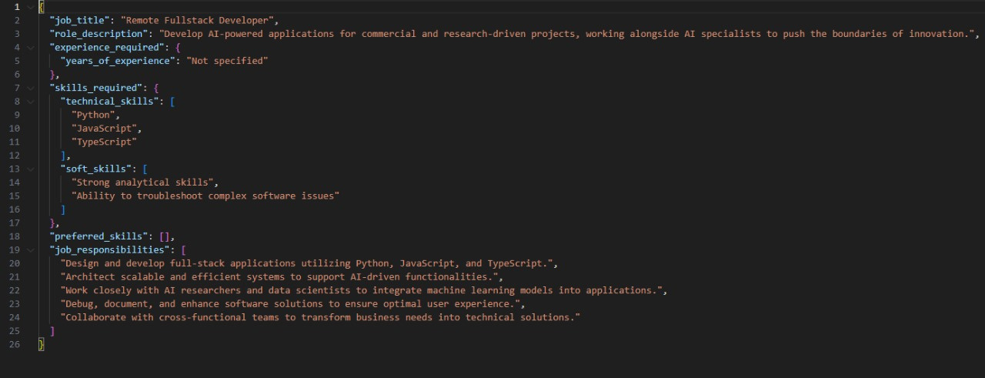
Job Desc to JSON

Slide 11
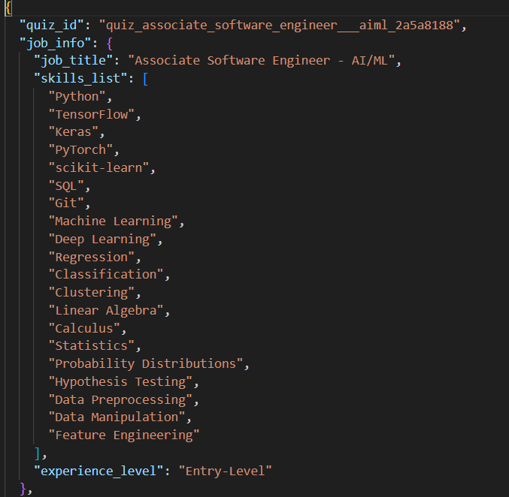
Questions according to Required Skills and Job Level

Slide 12
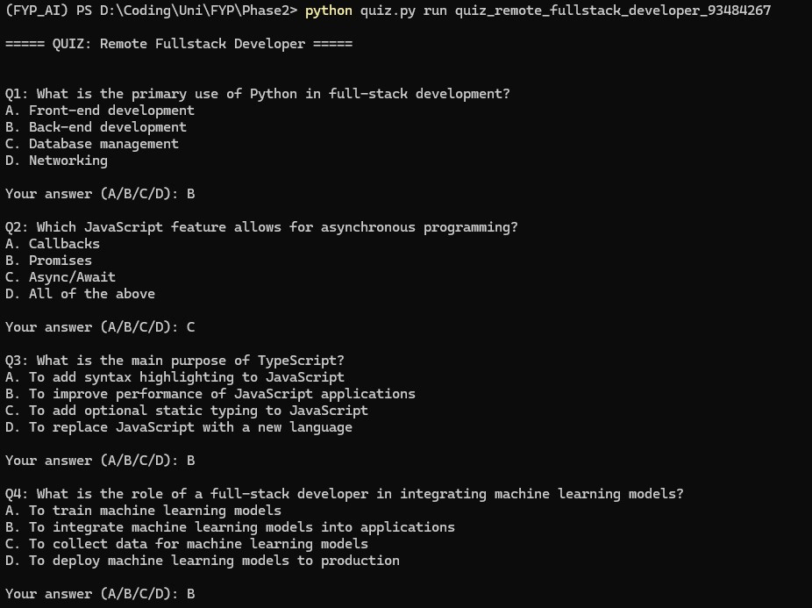
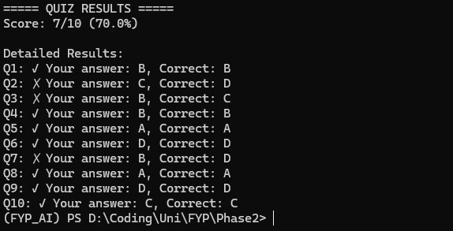
During Test
Test Results and Score

Slide 13
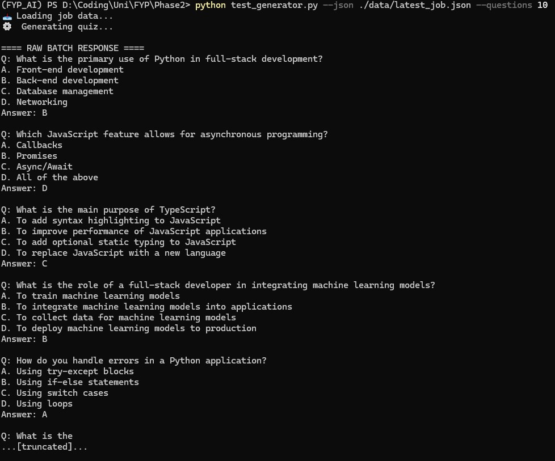
Select Number of Questions

Slide 14
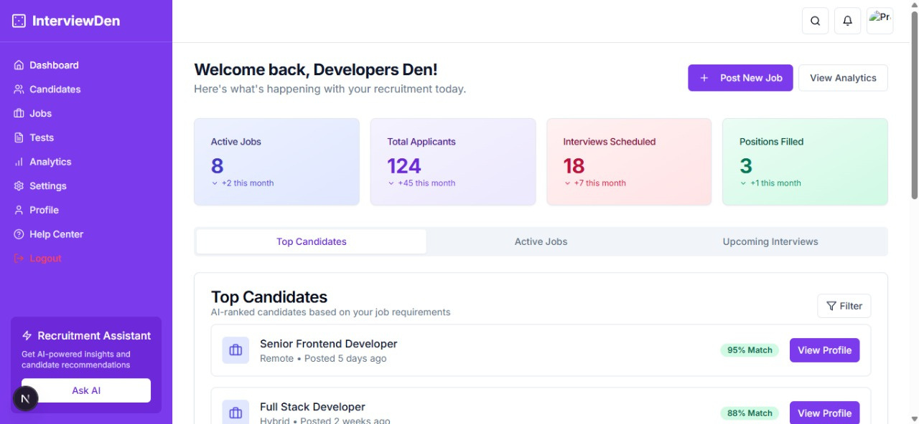
Company Portal Login

Slide 15
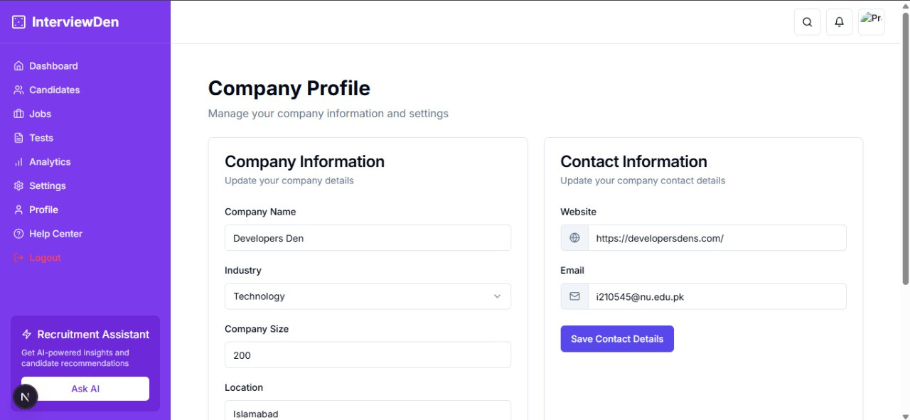
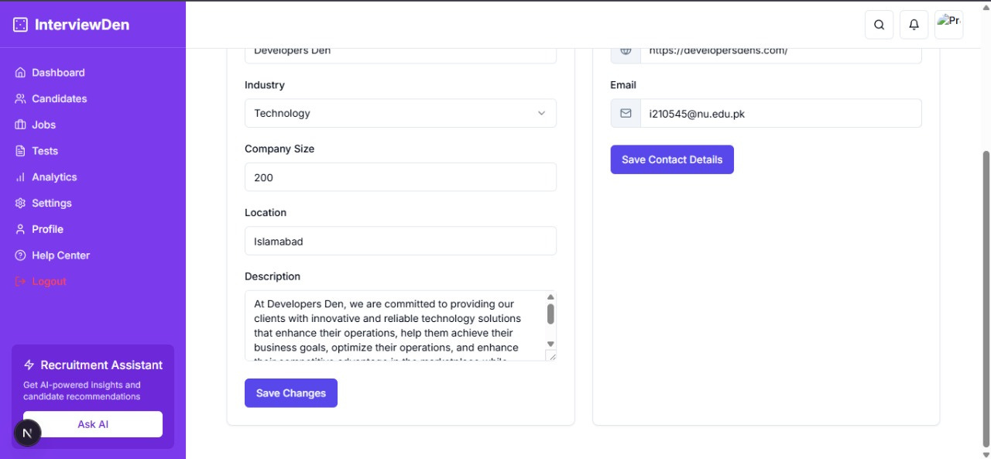
Company Profile

Slide 16
Database Connected and Storing Login and Profile Information

Slide 17
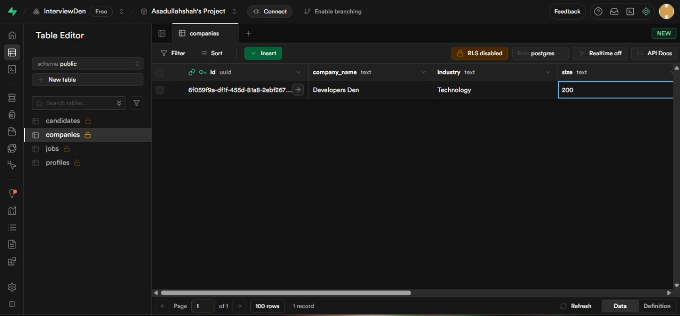
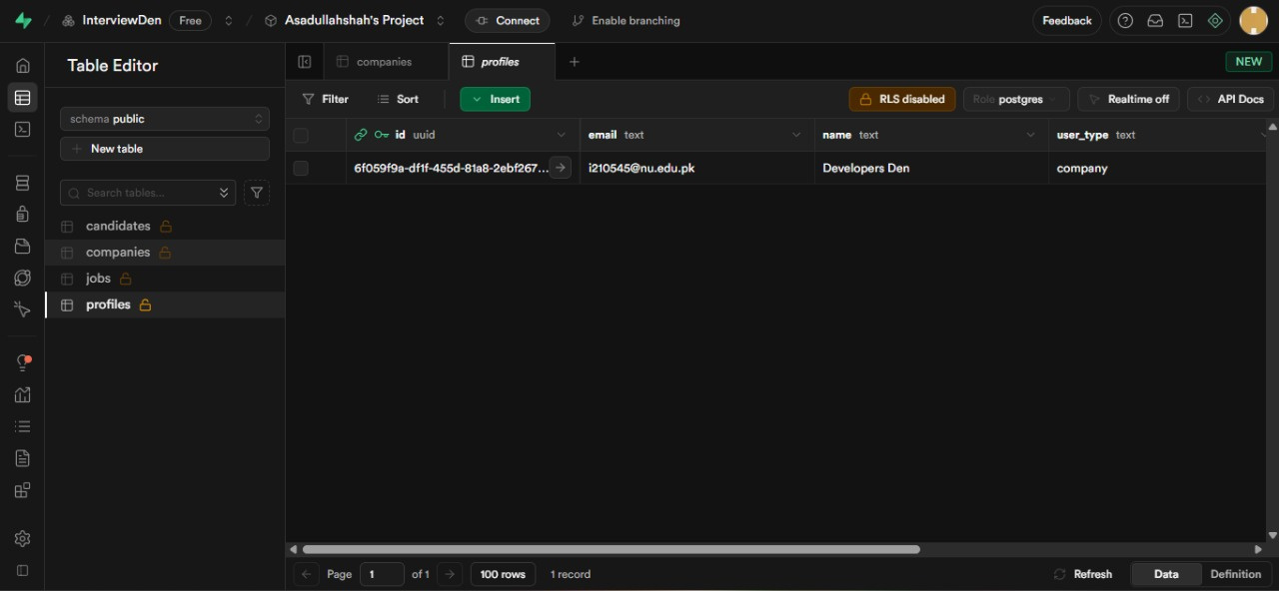

Slide 18
Done up to present time
AI Resume Screening
AI Test Creation
Separate Scoring and Evaluations for both
Complete Working Frontend
Role Based Working Login/Signup
Database Schema Created

Slide 19
Next Iteration
AI Interviews
Connect Candidate Portal Backend l

Slide 20
Thank you!
Any Questions?

Slide 21
Demo

